Slide 1
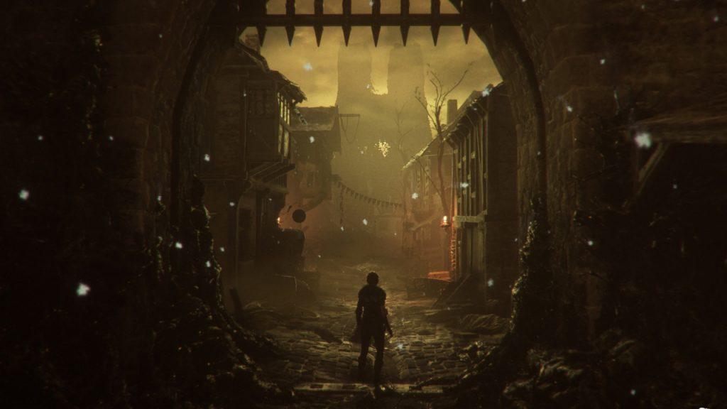
A Plague’s Tale
A proper modern take of British Literature
By: Gwen DiPiano

Slide 2
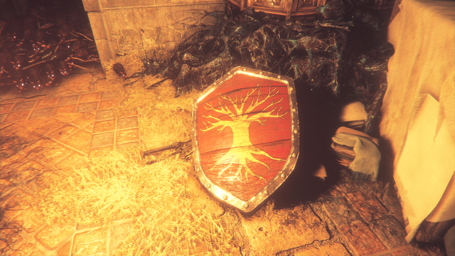
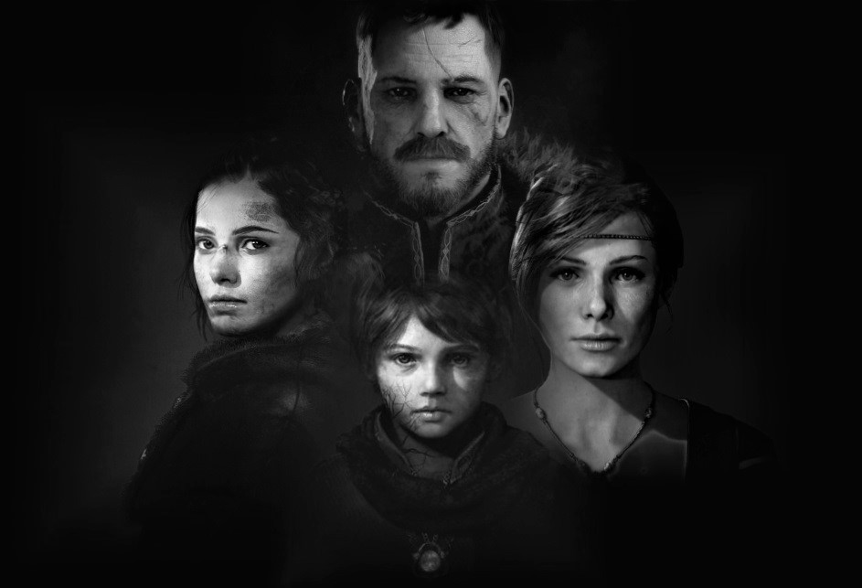
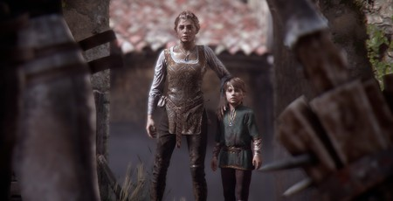
Plot Overview: Who

Slide 3
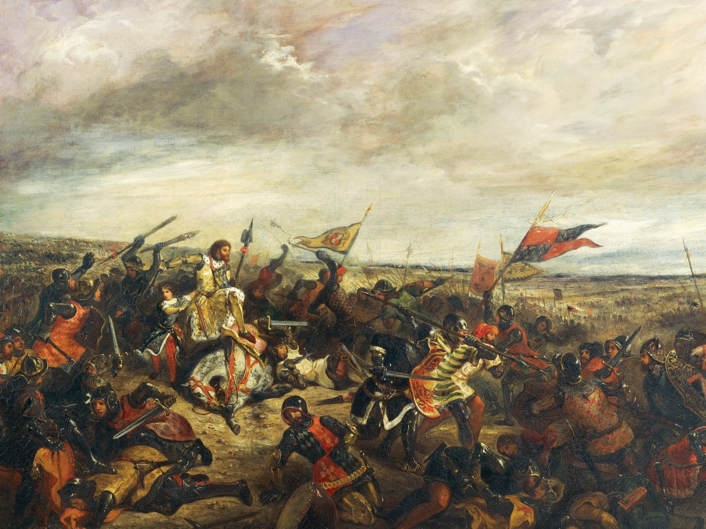
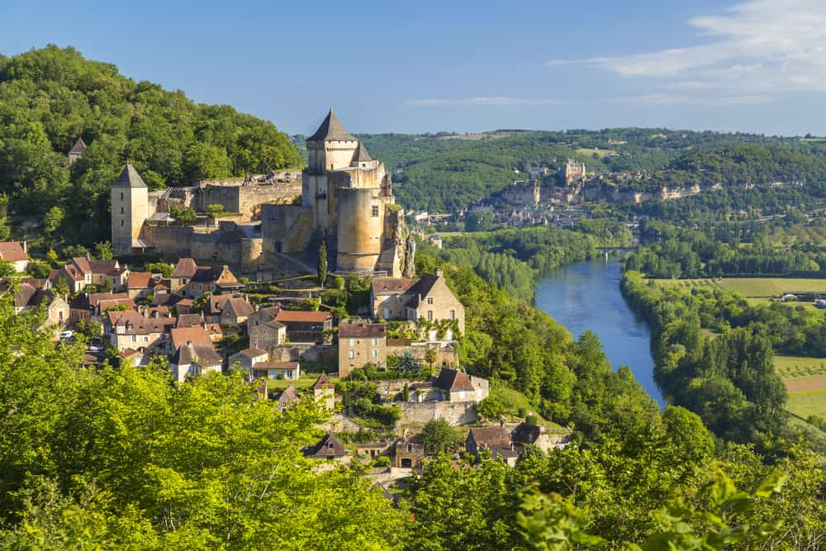
Historical Context

Slide 4
Related Stories
The Green Knight Beowulf “Black Death” Matters: A Modern Take on a Medieval Pandemic
-Nature
-Family
-Honor
-Lighting
-Themes
-Honor
-Religion
-Family
-Hero’s Journey
-Timeline
-Politics
-The Black Plague

Slide 5
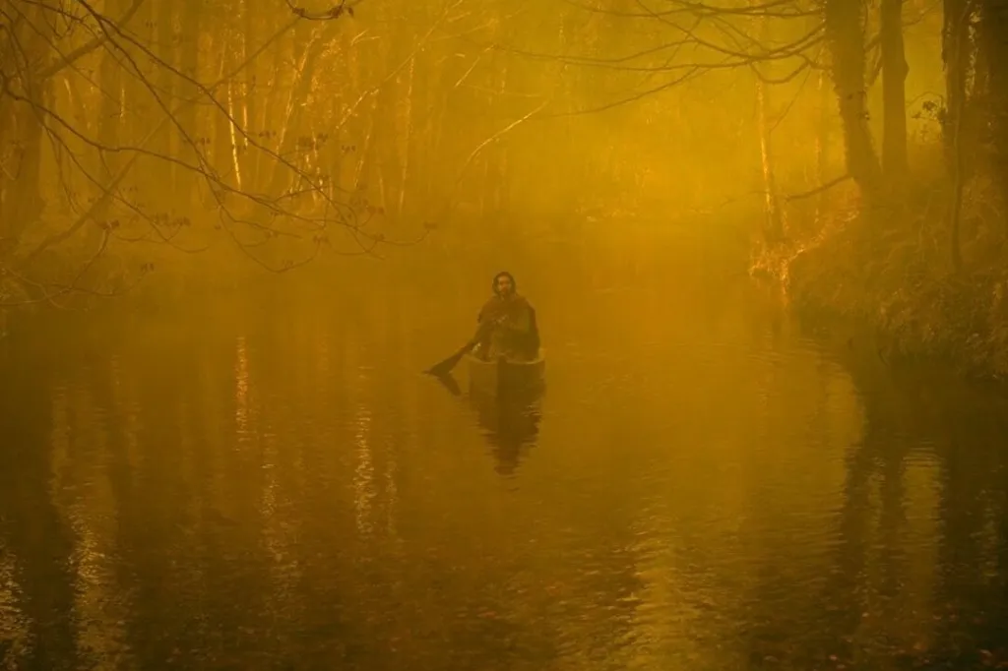
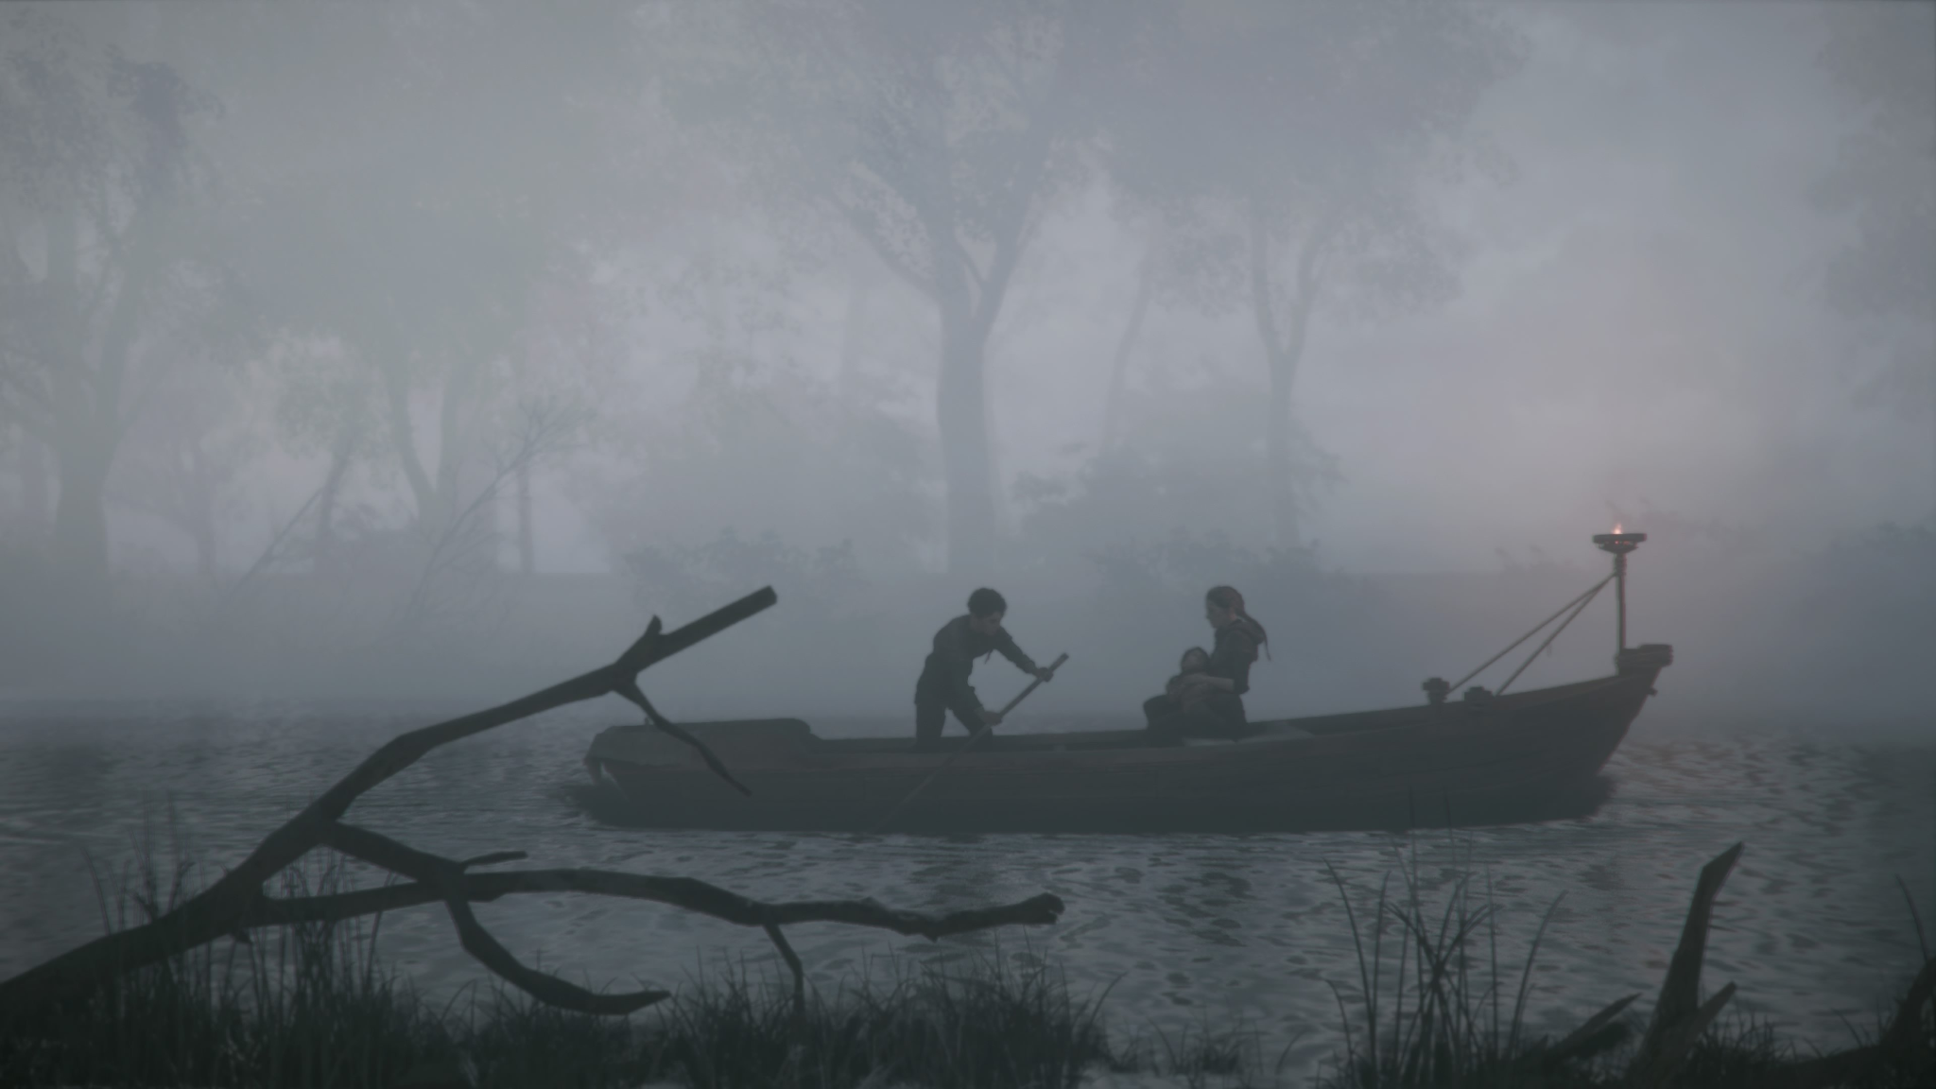
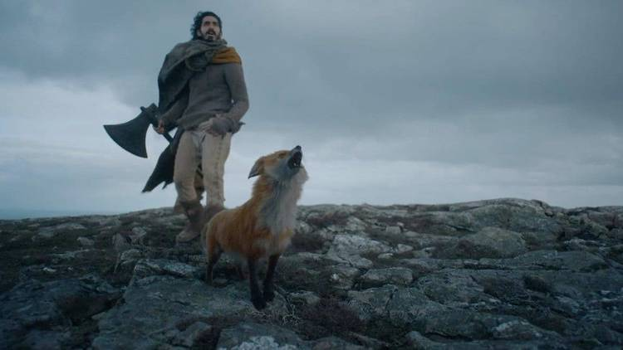
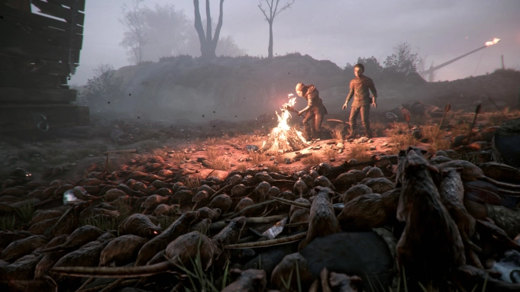

Slide 6
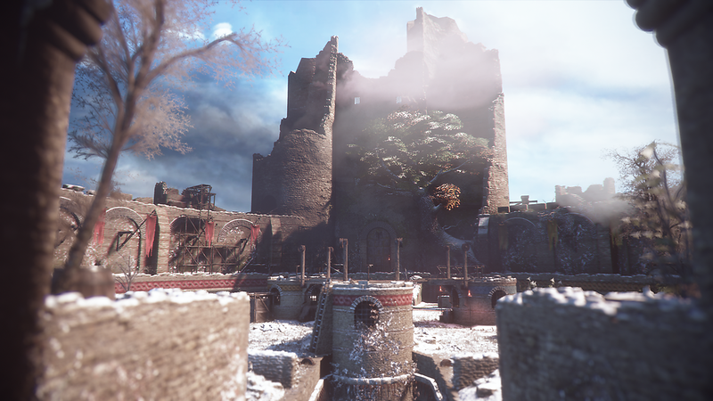
“Then he goes to the mound and walks around it,
Wondering to himself what it could be.
It had a hole at the end and on either side,
And was covered all over with patches of grass,
And was all hollow inside; nothing but an old cave,
Or a fissure in an old rock, what to call it he hardly
could tell.”
(2178 - 2184)

Slide 7

What Happens:

Slide 8
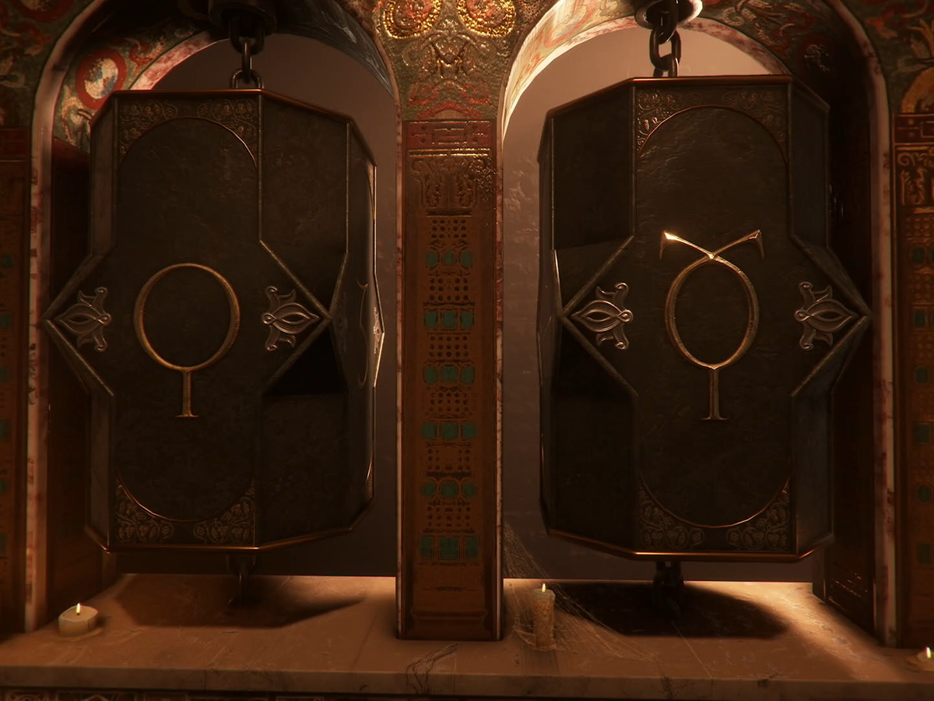
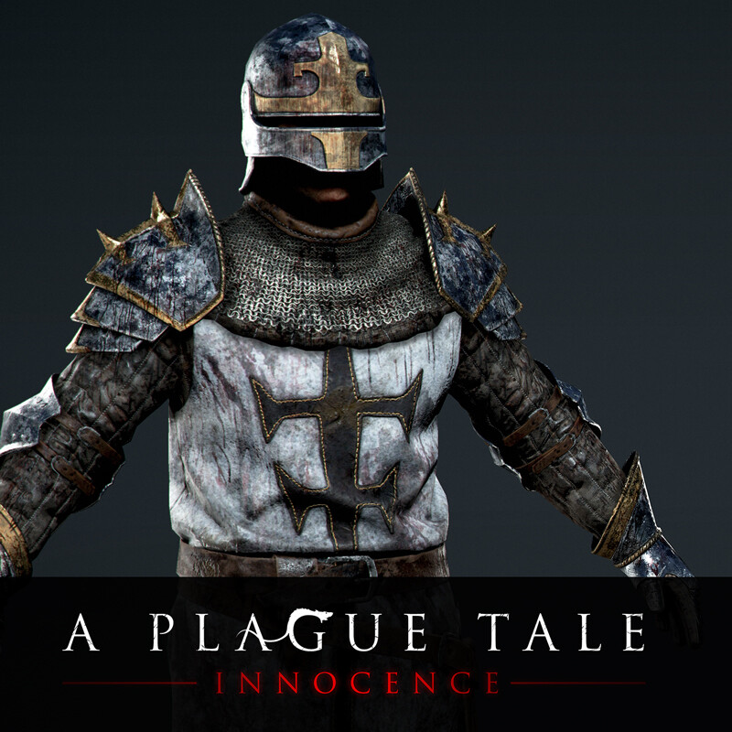
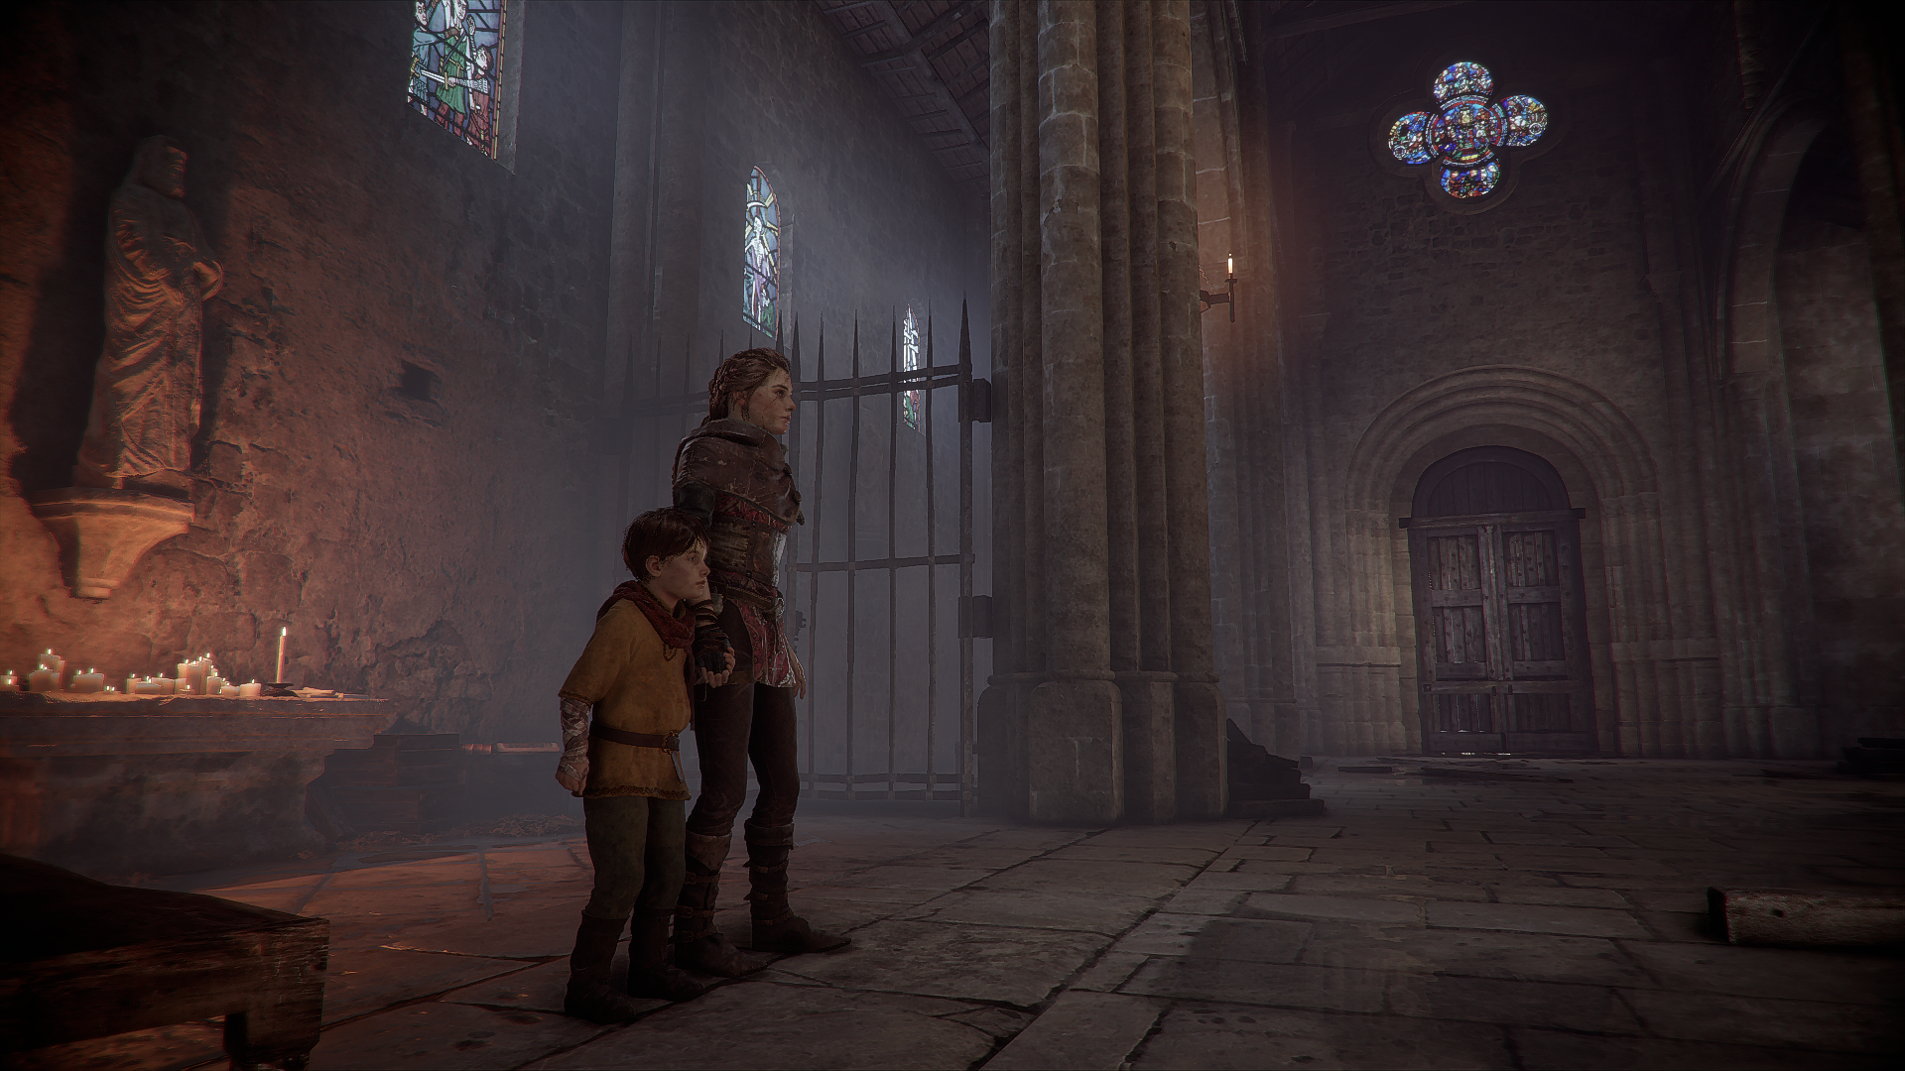
The Inquisitors

Slide 9
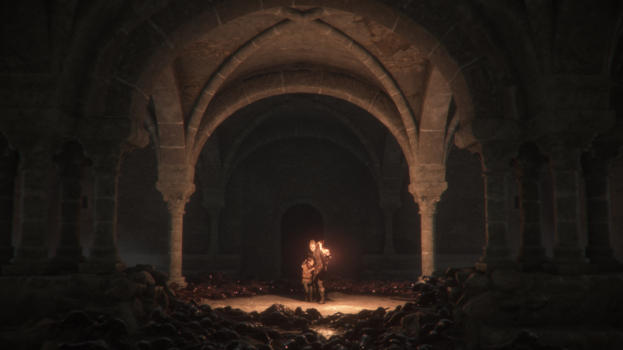
Theming: Hope and Revenge

Slide 10
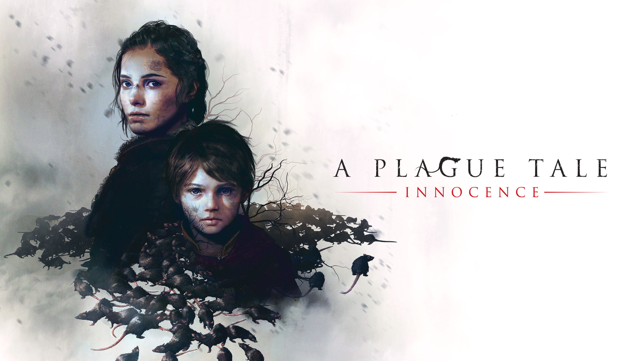
Thank you

Slide 11
Sources
Photos Only, Articles/Text/Movie in script (Photos are also mostly from the Game/Movie)
https://www.godisageek.com/reviews/a-plague-tale-innocence-review/
https://www.deviantart.com/dark-rider28/art/De-Rune-Family-839461747
https://bit-tech.net/reviews/gaming/pc/a-plague-tale-review/1/
https://ag.hyperxgaming.com/article/7562/how-long-to-beat-a-plague-tale-innocence
https://variety.com/2018/gaming/features/a-plague-tale-innocence-interview-1202850698/
https://www.history.com/topics/middle-ages/hundred-years-war
https://fransdejonge.com/2019/12/a-plague-tale-innocense-is-boring/
https://shuma.artstation.com/projects/N58OPN

